Slide 1
User Inputs

Slide 2
Introduction
Need for a program to get inputs from the user
Standard input device
Keyboard / Keypad
Represented through
System.in

Slide 3
Scanner Helper Class
A need to receive data from the default input device
A need to convert data to the appropriate formats
Scanner class
Helper class available to connect to the keyboard device
Can be used to receive and convert inputs

Slide 4
Usage of Scanner
Scanner input = new Scanner(System.in);
Create a Scanner object that can scan for input from the keyboard
Note
The class java.util.Scanner needs to be imported
The portion on the left declares an object of type Scanner
The portion that is to the right is to create a new Scanner object

Slide 5
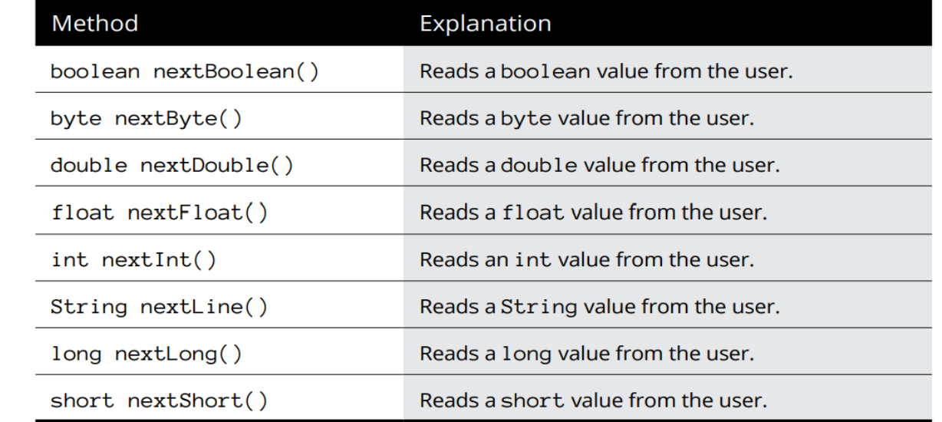
Scanner - Read Methods

Slide 6
Demo - Reading input
Program to read input
Make use of Scanner object
Make use of the next() methods to read an input
Print the value to the console
Example
Refer ScannerDemo1.java

Slide 7
Demo - Avoiding Read Errors [1]
Possible that user can provide incorrect inputs
Results in program crash
Scenario
Steps
Program expects an integer to be entered by the user
User inputs a string
Program crashes
Example
Refer ScannerReadErrorDemoV1.java

Slide 8
Demo - Avoiding Read Errors [2]
To avoid errors, check if the input type is correct and then accept it
Make use of hasYYY() methods
Examples
hasNextInt()
hasNextBoolean()
Example
Refer ScannerReadErrorDemov2.java

Slide 9
Summary
Usage of Scanner object
Read methods available in Scanner
To read inputs from the user
To avoid user input errors by providing condition check

